Slide 1

From
“Pause to Power”
Women's Career Break to Reentry

Slide 2

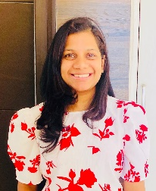
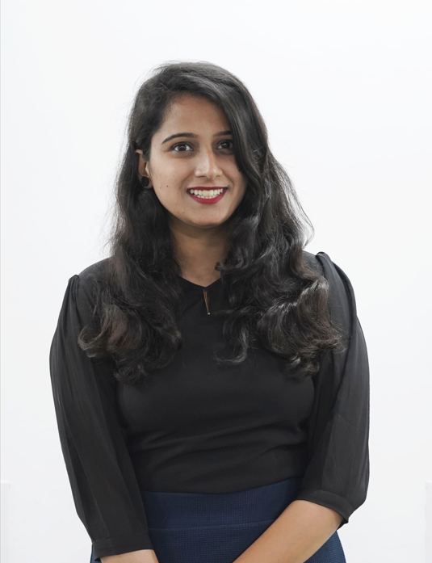
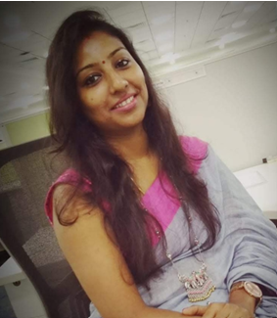

CAPSTONE Project
- Group 5
Divya Merwani
Pune
HRBP
PRGX Global Inc.
Team Members

Slide 3

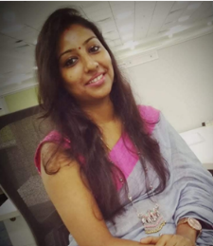

CAPSTONE Project
- Group 5
Nandini Sounderraj
Bangalore
Manager- HR
Bangalore Metro Rail Corporation Ltd.
Team Members

Slide 4
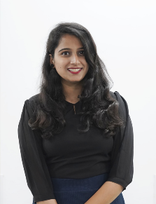



CAPSTONE Project
- Group 5
Soumya Sahadevan
New Delhi
Head Talent Strategy
Defence Bakery Pvt Ltd (Alma Foods)
Team Members

Slide 5




CAPSTONE Project
- Group 5
Rathi Pula
Hyderabad
Central TA- Branding and Marketing
Wipro Technologies
Team Members

Slide 6


CAPSTONE Project
- Group 5
Hema Malini
Hyderabad
HR Services Lead
Microsoft India Pvt Ltd
Team Members

Slide 7
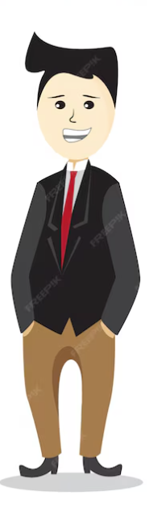
India’s Labour Force Participation Rate (LFPR)
As per the Census 2011, women comprise 48.5% India's total population
32.8%
2021
77.3%
33.9%
2022
78%
41.3%
2023
78.3%
*Periodic Labour Force Survey (PLFS) 2023

Slide 8
Worker Population Ratio (WPR)- India
Female
Rural
Urban
Male
80%
77.7%
60%
77.1%
70.4%
71.6%
40%
46.4%
36.7%
20%
22.8%
25.2%
2022
2023
2022
2023
*Periodic Labour Force Survey (PLFS) 2023

Slide 9
Women Employable Trend for last 10 Years
2014
45%
2016
48%
2018
50%
2020
52%
2022
53%
2024
51%

Slide 10

Literature Review
Global Economy Report (2023)
3
International Labor Organization Reports (2024)
The prevalence of “Job Gaps” particularly affect women as compared to men.
1
India struggles with one of the lowest rates of female labour participation globally, standing at 32.6%
4
LinkedIn Report (2022)
2
Deshpande et al (2023)
When switching to a new job or career, Indian women frequently encounter considerable difficulties juggling their personal and professional lives
According to the LinkedIn report, 77% of working women in India felt that a career break had a set back in their careers.

Slide 11


Problem Statement
“Women face challenges in returning to work post-career break”
Our study is an attempt to understand women’s re-entry to workforce from an organizational perspective.

Slide 12
OBJECTIVES
To understand the factors that influence women to take a career break
To identify the challenges faced by women while returning to work
To recommend a set of initiatives to organizations to retain working women post career break.

Slide 13

Research Methodologies
1
Research Design
Descriptive research to understand the career breaks and re-entry challenges of Indian women.
2
Sampling Method
Convenience sampling using the snowball technique.
3
Data Collection
Survey Method
4
Data Analysis
4.1
Quantitative data
4.2
Qualitative data
Descriptive statistics to summarize the characteristics of the sample
Open-ended responses were analyzed to identify recurring themes, patterns, and insights related to career break

Slide 14
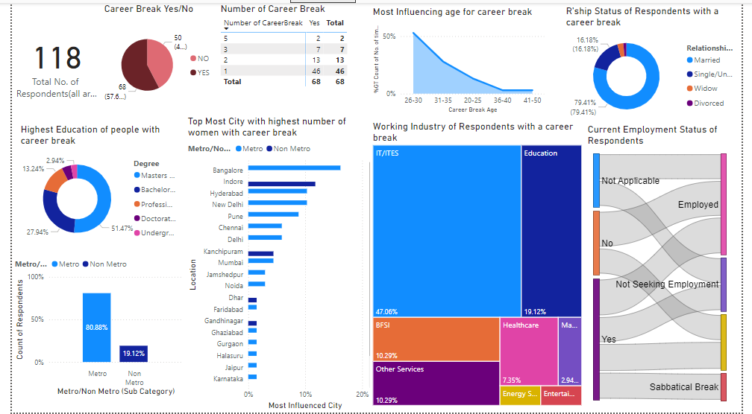
Analysis 1 - Demographics

Slide 15
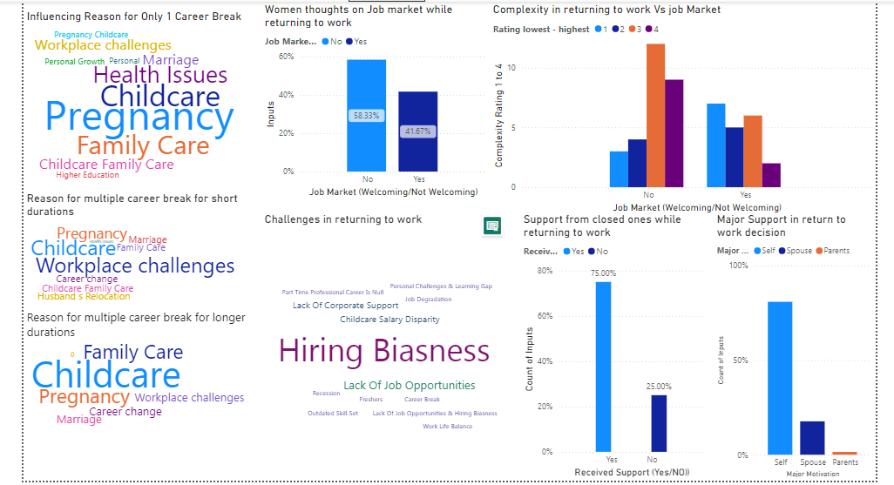
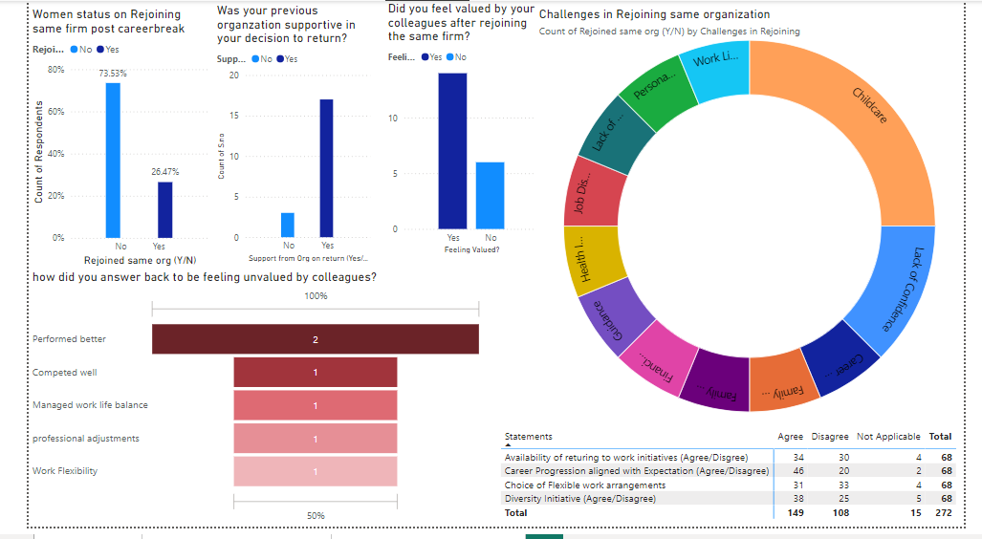
Analysis 2 - Reasons of career break & Challenges in retuning to work

Slide 16
Career Break
As per the survey conducted PAN India on women returning to work from career break below are the outcome of the research done
79%
53%
16%
28%
Married
Pregnancy, Childcare, Marriage
Unmarried
Family Care, Health, Workplace Challenges
Women who are married had taken career break
Top contributor for married women taking career break
Unmarried women taken career break
Reason for unmarried women taking career break

Slide 17
Findings
As per the survey conducted PAN India on women returning to work from career break below are the outcome of the research done
The major age bracket of women taking career break is between the age of 26-30.
68% of them have had only 1 career break.
women in the age limit of 36 - 40 have taken an average of around 2 career breaks.
The average age group of respondents was around 36 years and they were in their mid level career with around 11 yrs of experience.

Slide 18
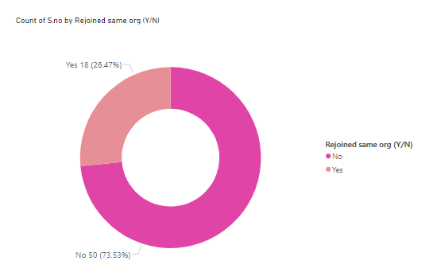
Returning to Work
Out of 118 Women, 68 (58%) Women had Career Break in their professional journey
When decided to return to work Out of these 68 Women, 27% of them rejoined the same organization, and rest of them decided to move on with other opportunities
(Refer Image 1)
Image 1

Slide 19








82%
59%
Says complexity to return to work is higher
Women Workforce who took a career break are presently employed.
Findings
35%
74%
Felt Hiring biasness while returning to work
Did not rejoin the same org.
45%
58%
Out of 74% says complexity is high.
Out of 74% says market is not welcoming

Slide 20
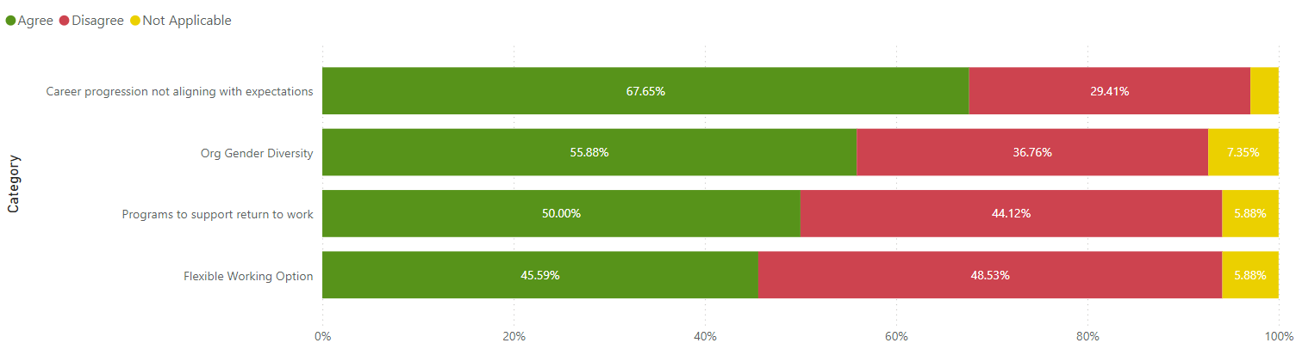
Expectation Vs Reality

Slide 21
Suggestions
Create an Inclusive Workforce
Enable Potential
Talents
Encourage Re-entry to work
HR Policies
Develop strategies to create a more inclusive workforce
Enhance the Corporate sensitivity about re - entry of women workforce enabling to tap the potential talents
Reframe HR policies that are more accommodative to women workforce to rejoin the same organization after career breaks
Encourage and motivate women through return to work program by the prospective employers.

Slide 22


